Slide 1
Web Technology 2
Image, Link & Form
Image
Links
Link Types
Linking Between Frames
Marquee Form
Form Action

Slide 2
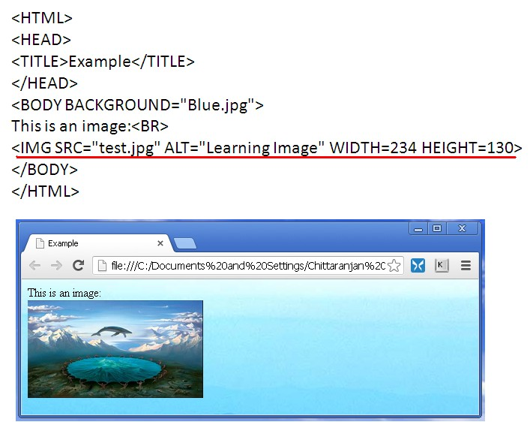
Image
Image
Border can be added to an image by using border attribute. Similarly, alignment can be set using align attribute
Image
Links
Link Types
Linking Between Frames
Marquee Form
Form Action

Slide 3
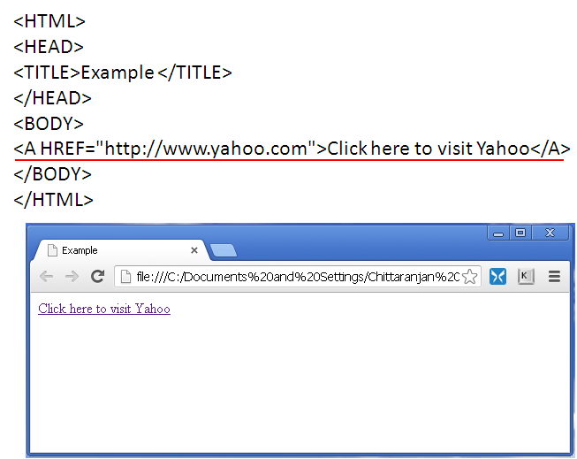
Links
Links
Text Links
Image
Links
Link Types
Linking Between Frames
Marquee Form
Form Action

Slide 4
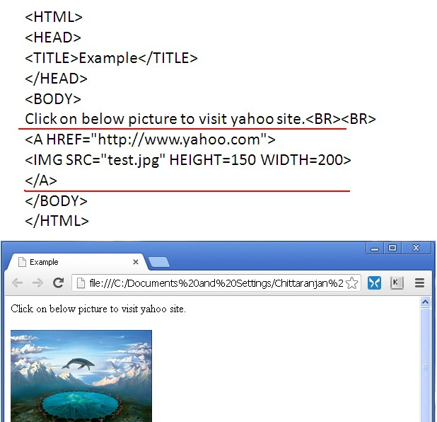
Links...
Links
Image Links
Image
Links
Link Types
Linking Between Frames
Marquee Form
Form Action

Slide 5
Link Types
Relative Link
It points to a location that is relative to the current page
Having a link to index.html is a relative link that points to
Link Types
the index.html page in the same directory as the current page
Linking Between Frames
Marquee Form
Form Action
The link can break if you move a file to another directory &
thus change the relative position of the link’s destination
Site Root-Relative Link
It points to a location that is relative to the root directory of
the site. It begins with a slash /
Having a link to /index.html is a site root-relative link that
points to the index.html page in the root directory of the site. Ex: This is used to have all images in an images directory and then to link images
The link stays the same no matter what directory the
current page is in

Slide 6
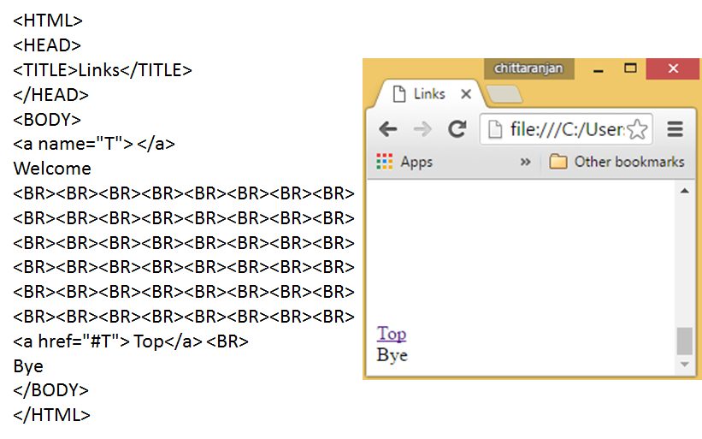
Link Types...
Absolute Link
It is simply one that includes the entire path to the file
These are generally used for links that need to point to a
Link Types
different site than the one on which your page is located
Linking Between Frames
Marquee Form
Form Action
In-Text Link
It is one that links to some other part of the same page

Slide 7
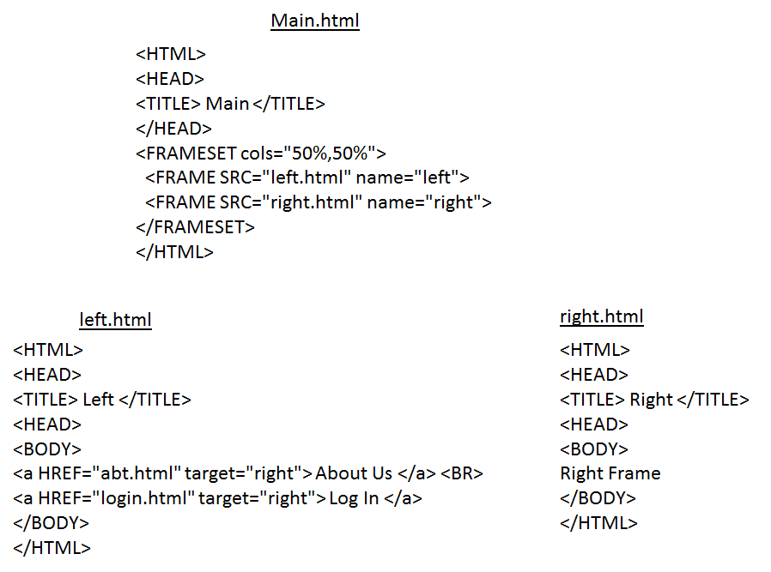
Linking Between Frames
Linking Between Frames
Image
Links
Link Types
Linking Between Frames
Marquee Form
Form Action

Slide 8
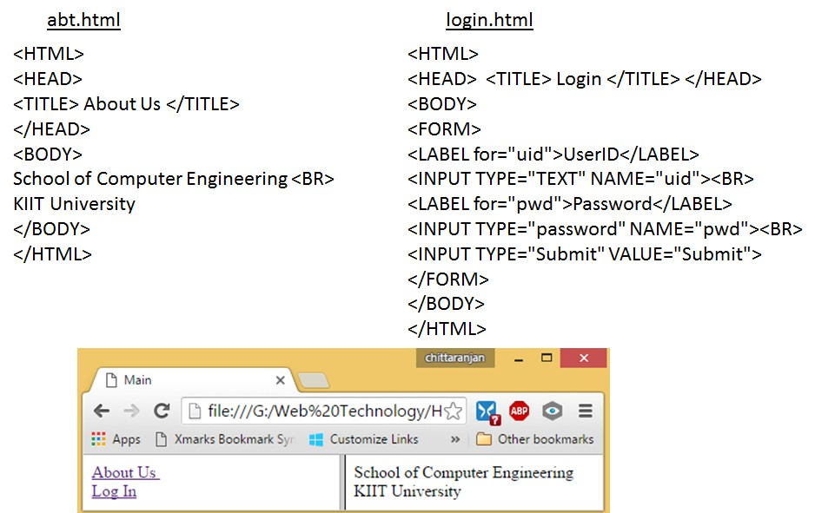
Linking Between Frames...
Linking Between Frames
Image
Links
Link Types
Linking Between Frames
Marquee Form
Form Action

Slide 9
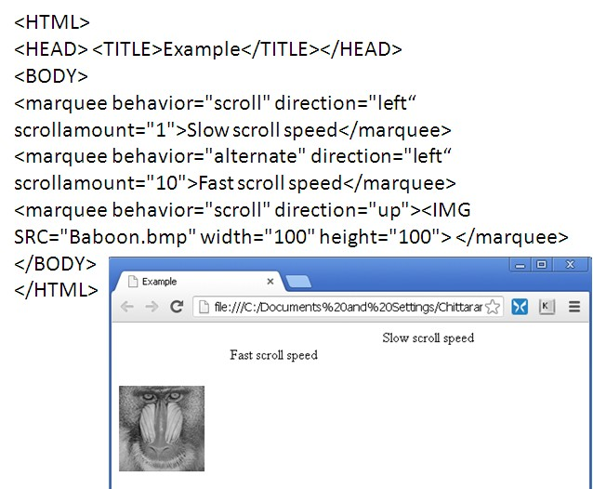
Marquee
Marquee
Marquee is used to set a scrolling text or image
direction: left, right, up, down
behavior: scroll, slide, alternate
scrollamount:
Marquee
Form
Form Action

Slide 10
Form
Form
An HTML form is a section of a document containing
normal content, markup, special elements called controls (checkboxes, radio buttons, menus, etc.), and labels on those controls
Form
A single page can include several different forms, but you
Form Action
cannot nest one form inside another
The name attribute identifies each form on the page. It is also needed for programs that retrieve values from the form
HTML Forms are required when you want to collect some data from the site visitor
The control type defined by the INPUT element depends on the value of the type attribute
placeholder attribute specifies a short hint that describes the expected value of an input field

Slide 11
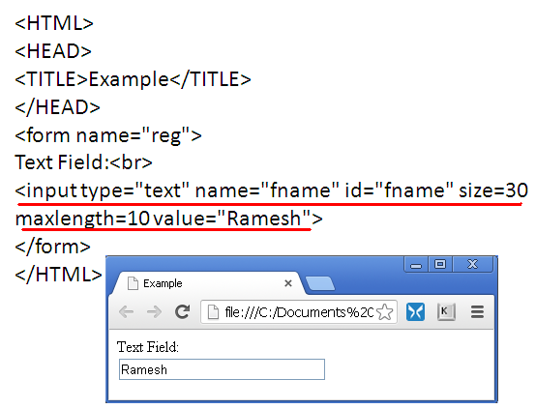
Form...
Text Box
Image
Links
Link Types
Linking Between Frames
Marquee
It is a text box where user can enter some characters
Form
Form Action

Slide 12
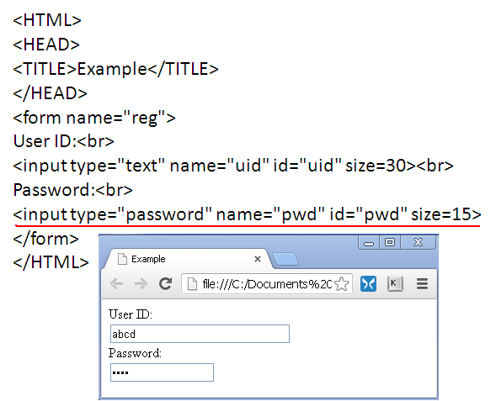
Form...
Password
A password field is a text box in which the characters typed by the user are displayed as bullets or asterisks
Form
Form Action

Slide 13
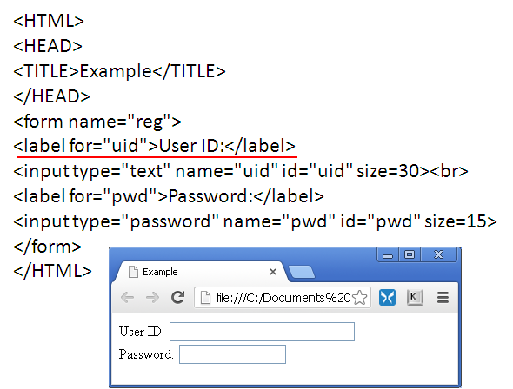
Form...
Label
You must bind the label to the id attribute of the field
Image
Links
Link Types
Linking Between Frames
Marquee
Form
Form Action

Slide 14
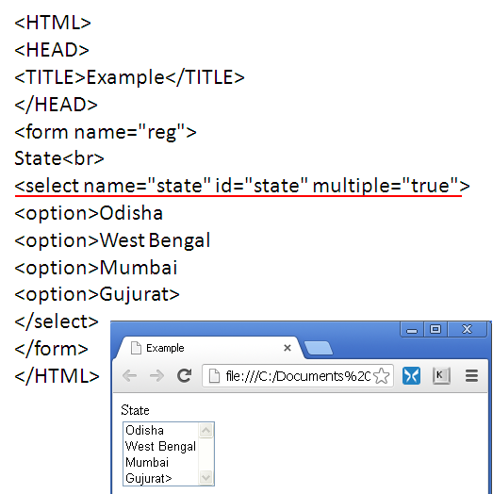
Form...
Selection List
A selection list is a list box from which a user selects a particular value or set of values
Form
Form Action

Slide 15
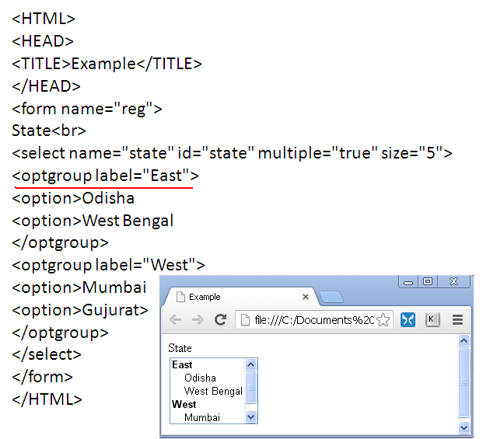
Form...
Selection List
Option Group is used to organize selection lists into distinct groups
Image
Links
Link Types
Linking Between Frames
Marquee
Form
Form Action

Slide 16
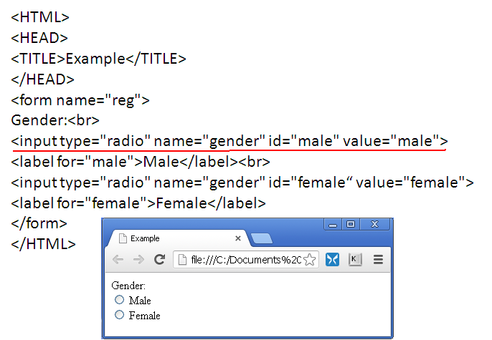
Form...
Radio Buttons
Image
Links
Link Types
Linking Between Frames
Marquee
Radio buttons display a list of choices from which a user makes a selection
Form
Form Action

Slide 17
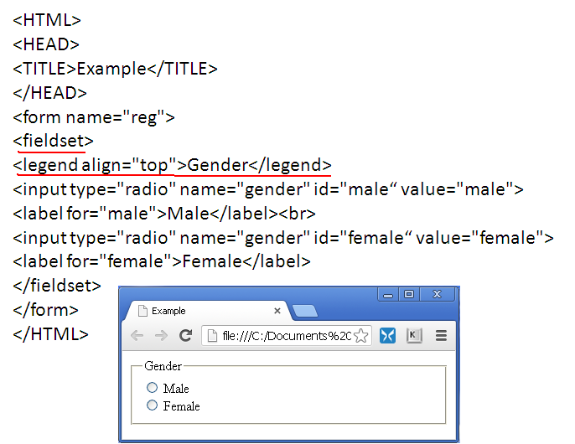
Form...
Group Box
It is a box placed around a set of fields that indicates that they belong to a common group
Form
Form Action

Slide 18
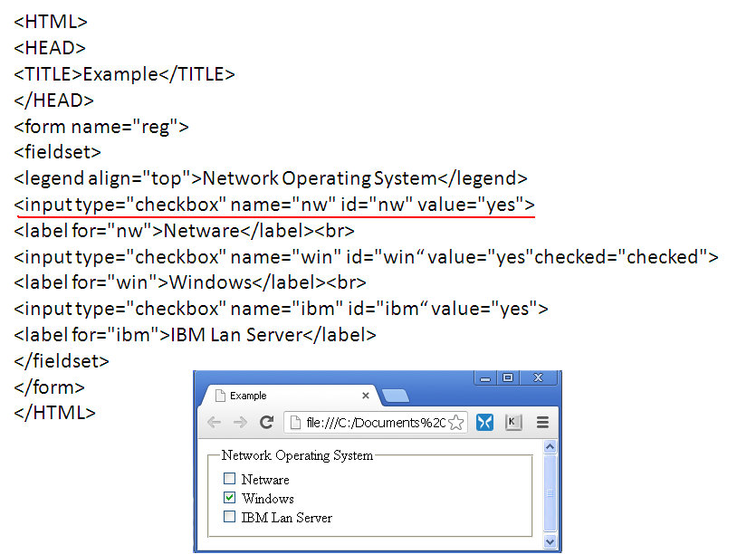
Form...
Check Boxes
A check box is either selected or not
Image
Links
Link Types
Linking Between Frames
Marquee
Form
Form Action

Slide 19
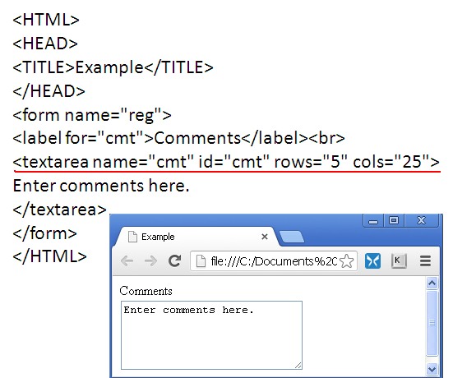
Form...
Text Area
It is an extension of a text field, where the text can span multiple lines
Image
Links
Link Types
Linking Between Frames
Marquee
Form
Form Action

Slide 20
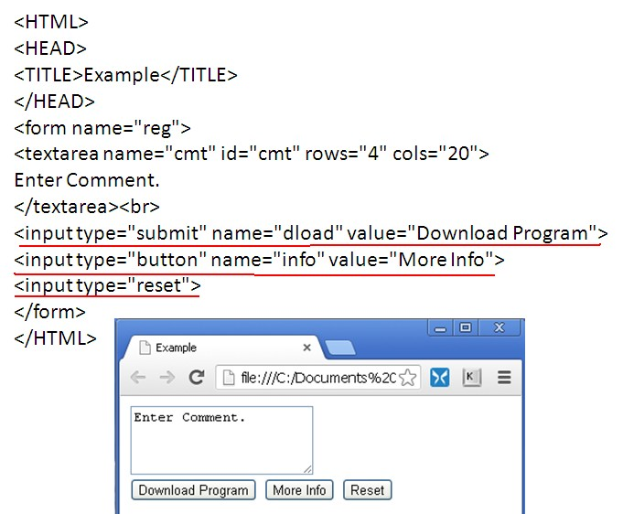
Form...
Buttons
A submit button is a button that submits the form
A reset button resets the form to its original (default) values
Push buttons by themselves perform no actions in the
Web page. To create an action, write a script or program that runs automatically when the button is clicked
Form
Form Action

Slide 21
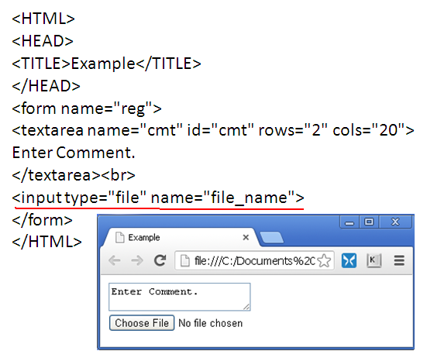
Form...
File Button
It is used to choose a file
Image
Links
Link Types
Linking Between Frames
Marquee
Form
Form Action

Slide 22
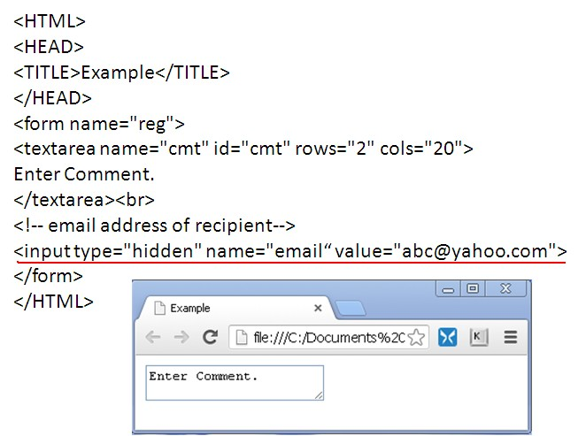
Form...
Hidden Field
A hidden field is added to the form but not displayed in the Web page. Because the field is hidden, it can be placed anywhere between the opening and closing <form> tags
Form
Form Action

Slide 23
Form Action
Form Action
After adding the elements to your form, you’ll need to
specify where to send the form data and how to send it. The attributes are:
action
Form Action
method
enctype
Thegetmethod is the default
get appends the form data to the end of the URL specified in the action attribute
Thepostmethod sends form data in a separate data stream, allowing the Web server to receive the data through standard input
the post method is considered the preferred way of sending
data to a Web server
<FORM ACTION = Ëxample.html METHOD = post »

